Slide 1
Million Song Dataset
Echonest Taste Profile Dataset
Presentation by:
Achal Sancheti
Saurabh Choudhary
Sumit Deshmukh

Slide 2
Content
Introduction
About Dataset
Technology Used
MapReduce
Geographical locations of Artists
PIG
Graph Database
Microsoft Azure (Machine Learning)
Demo
Challenges
References

Slide 3
introduction
What is the Motivation ?
What is so Big about ”Big Data”?

Slide 4


Slide 5
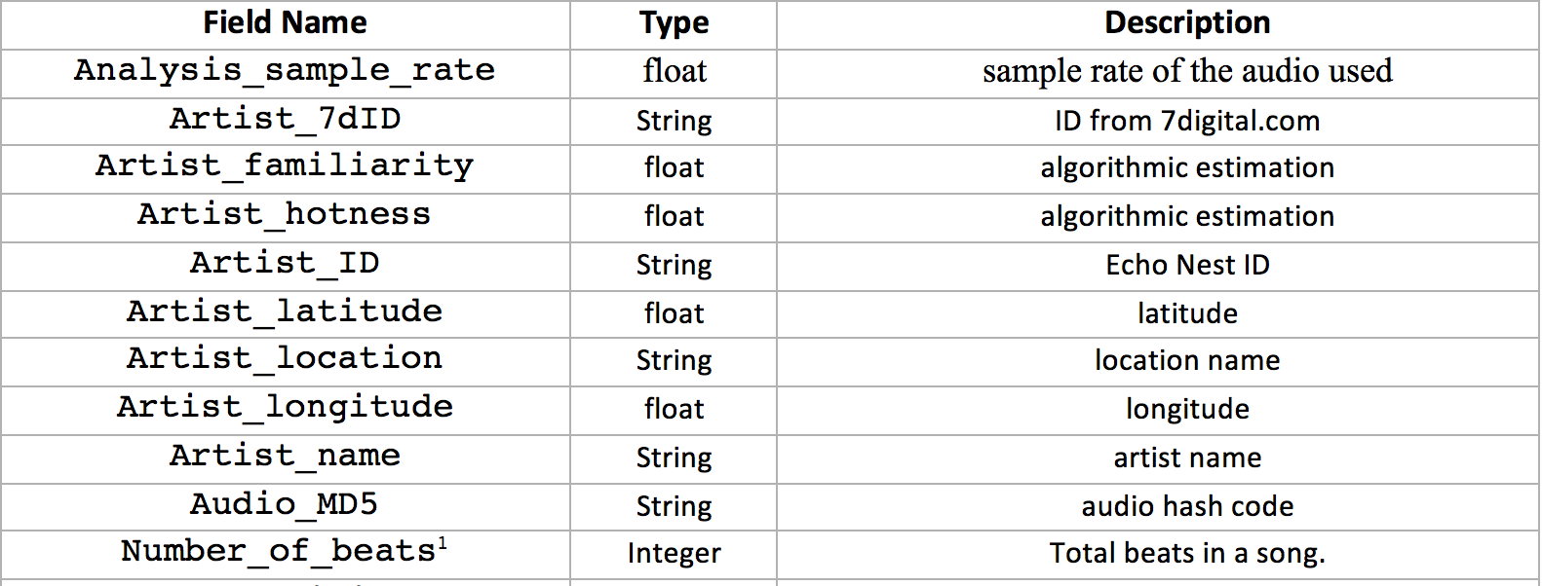
About Dataset
We have used Million Song Dataset that is a collection of 28 datasets containing audio features and metadata for a million contemporary popular music tracks.
Some of the interesting facts about the dataset:
280 GB of data
1, 000, 000 songs/files
44, 745 unique artists
7, 643 unique terms (Echo Nest tags)
2, 321 unique MusicBrainz tags
43, 943 artists with at least one term
2, 201, 916 asymmetric similarity relationships
515, 576 dated tracks starting from 1922

Slide 6
Technologies used
Apache Hadoop MapReduce 2.7.2
Apache PIG 0.16.0
Neo4j(Graph Database)
Microsoft Azure Machine Learning Studio
Amazon Web Services
Plotly to create graphs
Front-end technologies for web UI
Google API for maps
Python and Java

Slide 7
Hadoop MapReduce
Number of songs released in each year
This M/R (Map/Reduce) job simply calculates the number of songs released per year providing the overview of growth in song release through the years.
Mapper
Key: Year
Values: 1 for every Song ID in that year.
Reducer
Collect the year and sum the values.
Songs-vs-year

Slide 8
Hadoop mapreduce
Number of artists debuted per year
Calculates the possible number of artist that made a debut in a year. To extract this information, chained m/r job is used.
Mapper
Key: Year
Values: 1 for every Artist ID in that year.
Reducer
Collect the year and sum the values.
Artist per year

Slide 9
Hadoop mapreduce
Artists per MusicBrainz Tags
This M/R job identifies the distribution of artist across different genre depending upon the tags given to artists by users on MusicBrainz.com. This also requires chained M/R jobs.
Mapper 1
Key: Tag_Artist
Values: 1 for every Tag_Artist in that year.
Reducer 1
Collect the values and Sum.
Mapper 2
Key: Tag
Values: Artist_ID
Reducer 2
Collect all the Tags and sum the Number of Artists
Artists-per-musicbrainz-tag

Slide 10
Hadoop mapreduce
Analyzing the increase and decrease of song duration in each year
This M/R generates the average duration of songs for a given year.
Mapper
Key: Year
Values: Duration of each song in that year
Reducer
Sum all the duration and divide by number of values of songs in that year
Average-song-duration-per-year

Slide 11
Hadoop mapreduce
Analyzing the increase and decrease of beats for the songs over the period
Similar to average duration per year, this M/R is utilized to understand the trend of beats through years.
Mapper
Key: Year
Values: Number of beats of each song in that year
Reducer
Sum all the beats and divide by number of values of songs in that year
Average-beats-per-year

Slide 12
Hadoop Mapreduce
We have also performed several other MapReduce jobs such as:
Number of songs sung by an artist.
Number of play counts for each song.
Most dense, hottest, loudest and longest song in the dataset.

Slide 13
Geographical Location
A simple M/R to just emit the longitude and latitude for a given artist. This data is then utilized in Google Maps API and a plot of geographic distribution of artists is obtained. It simplifies identification of geographic hotspots of artists.

Slide 14
PIG
Uses ETL (Extract, Transform, Load)
Uses lazy evaluation
Top 50 most viewed songs
We have used Pig 0.16.0 version to execute the commands. It calculates the top 50 songs that have highest number of views with the number of users that have viewed it.
Top-50-played-songs

Slide 15
PIG
List of highest beats song before 1980
In the recent years, there are several songs with high number of beats. We were curious to know that what is the list of songs with highest number of beats before 1980. Therefore, this PIG program simply calculates the list of songs with highest number of beats before 1980. It also includes the title, artist name and loudness of that particular song.

Slide 16
PIG
We have also performed several other PIG operations to find:
Top 10 years with highest number of artist debut
Top 10 years with highest number of song release

Slide 17
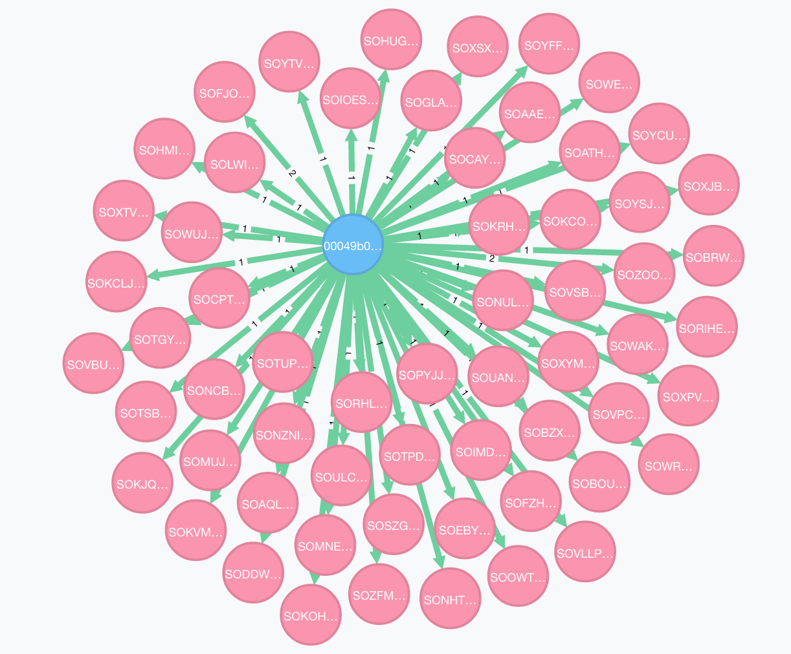
Neo4j
We used Neo4j graph database to represent relationship between a unique user and unique songs he listened to.
A Typical view of User Node and Song Nodes

Slide 18
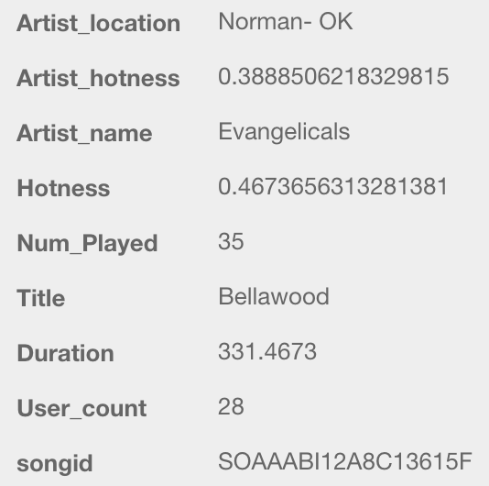
neo4j
Properties of each song Node in the Neo4j Database

Slide 19
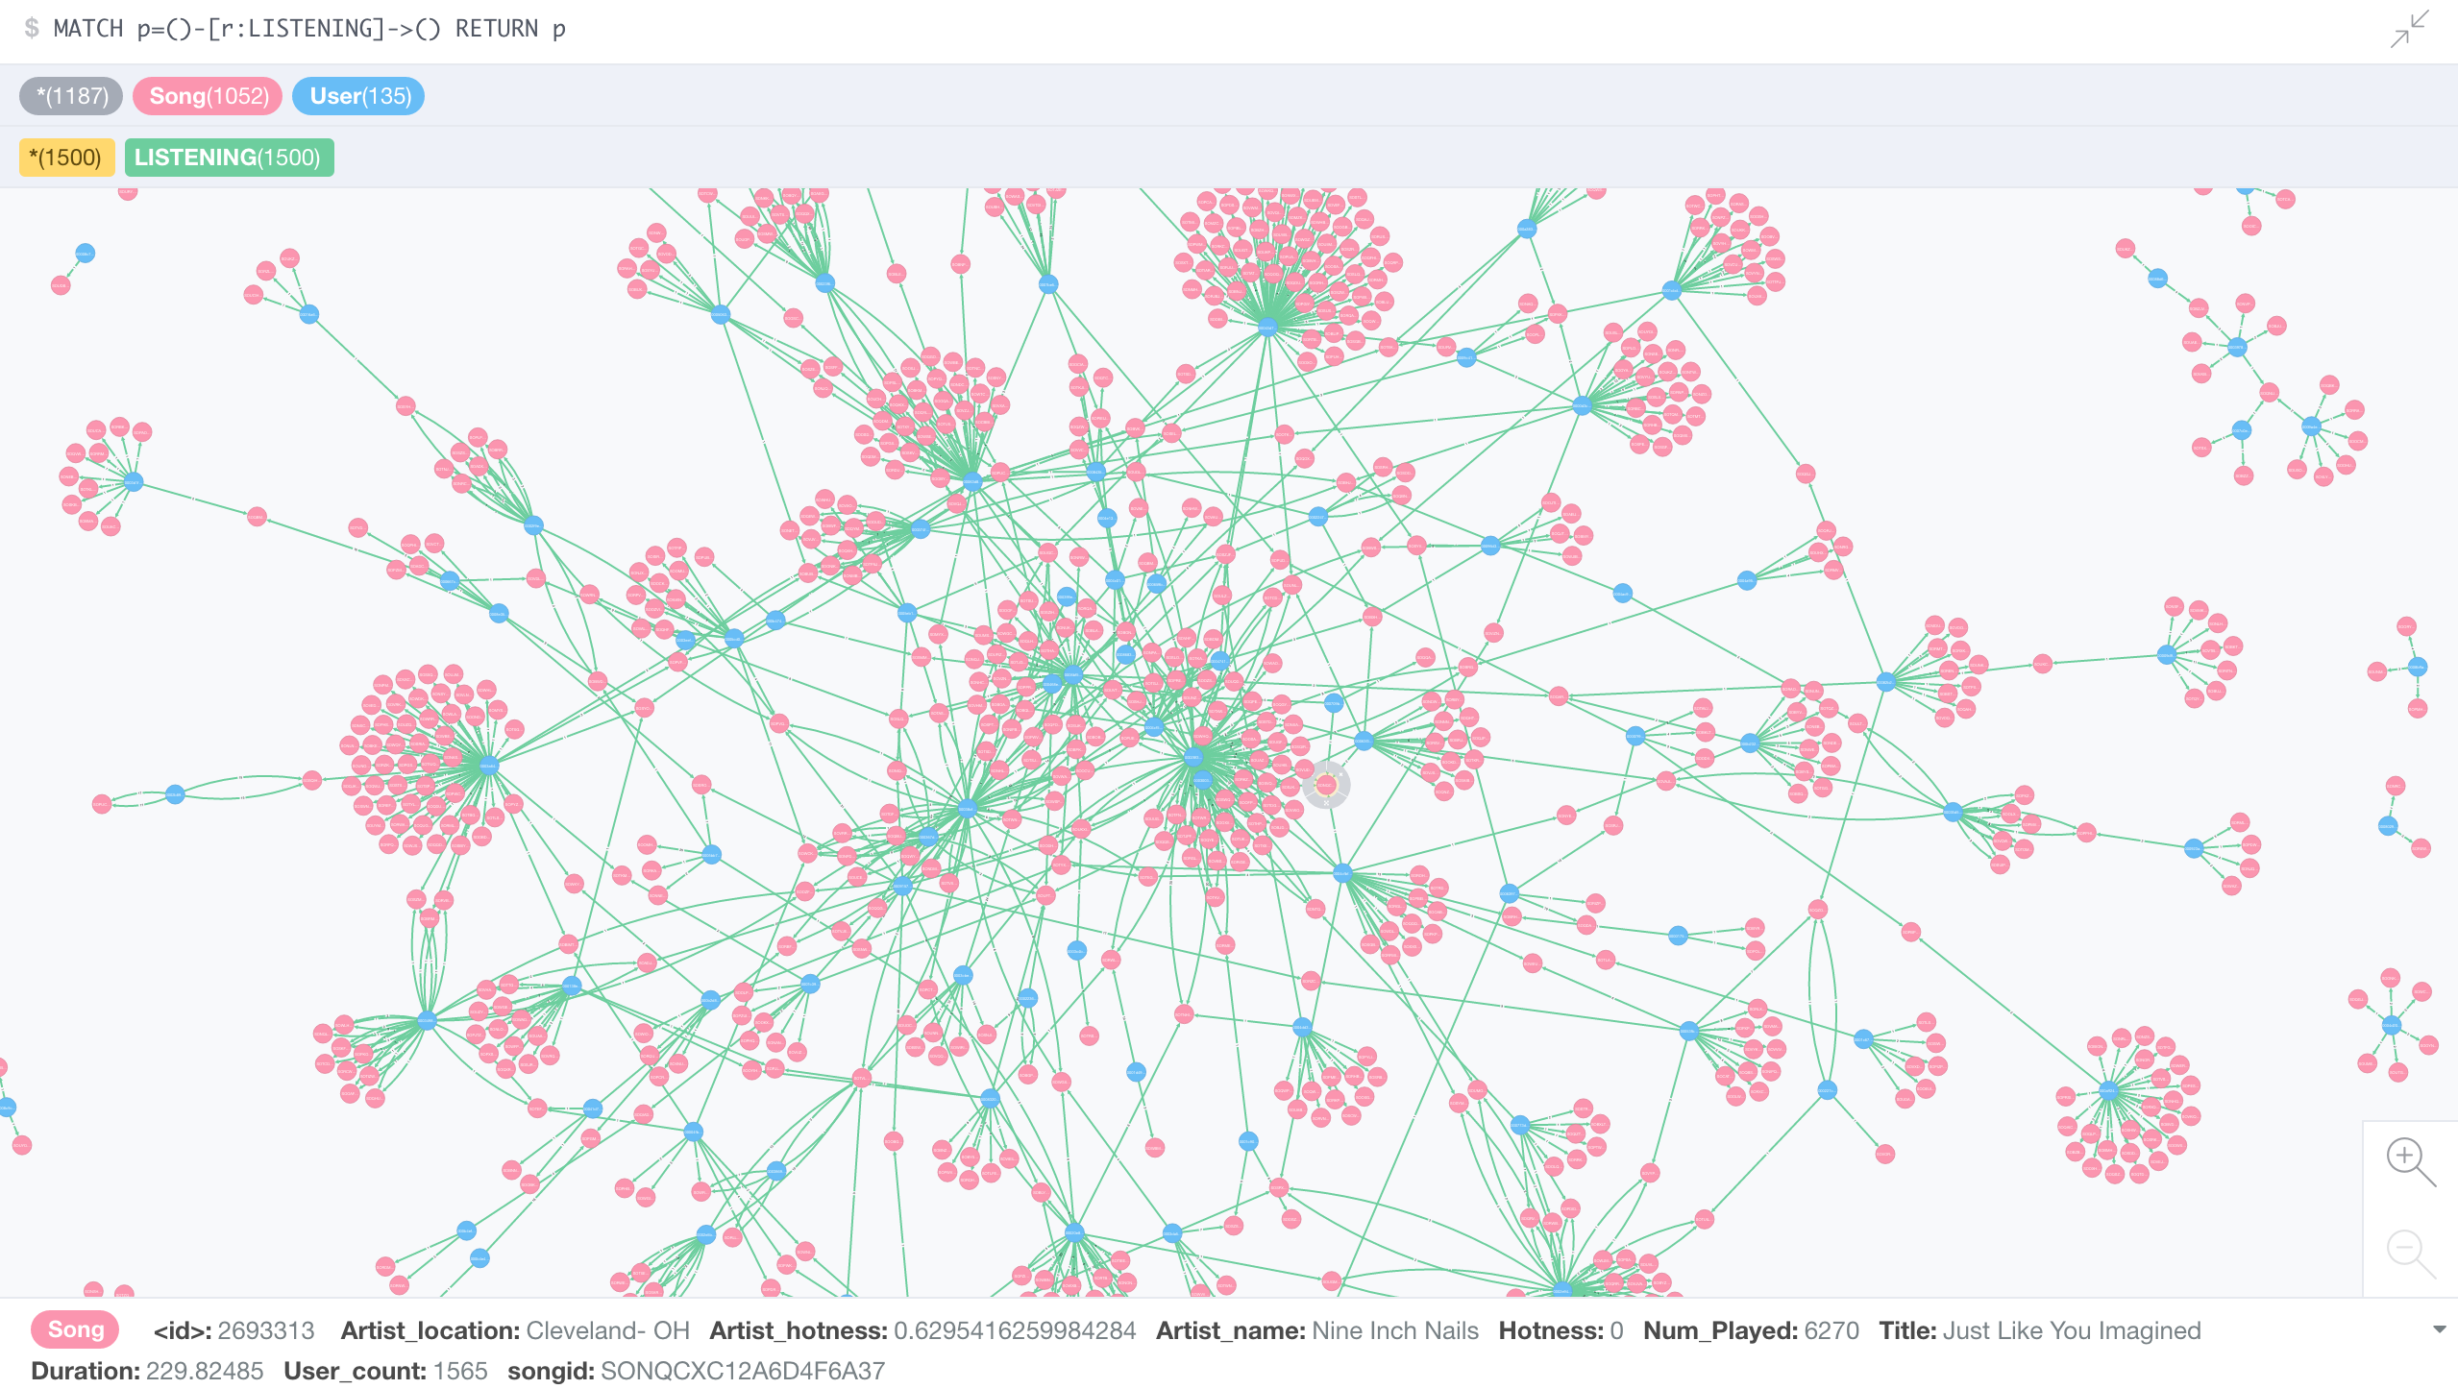

Slide 20
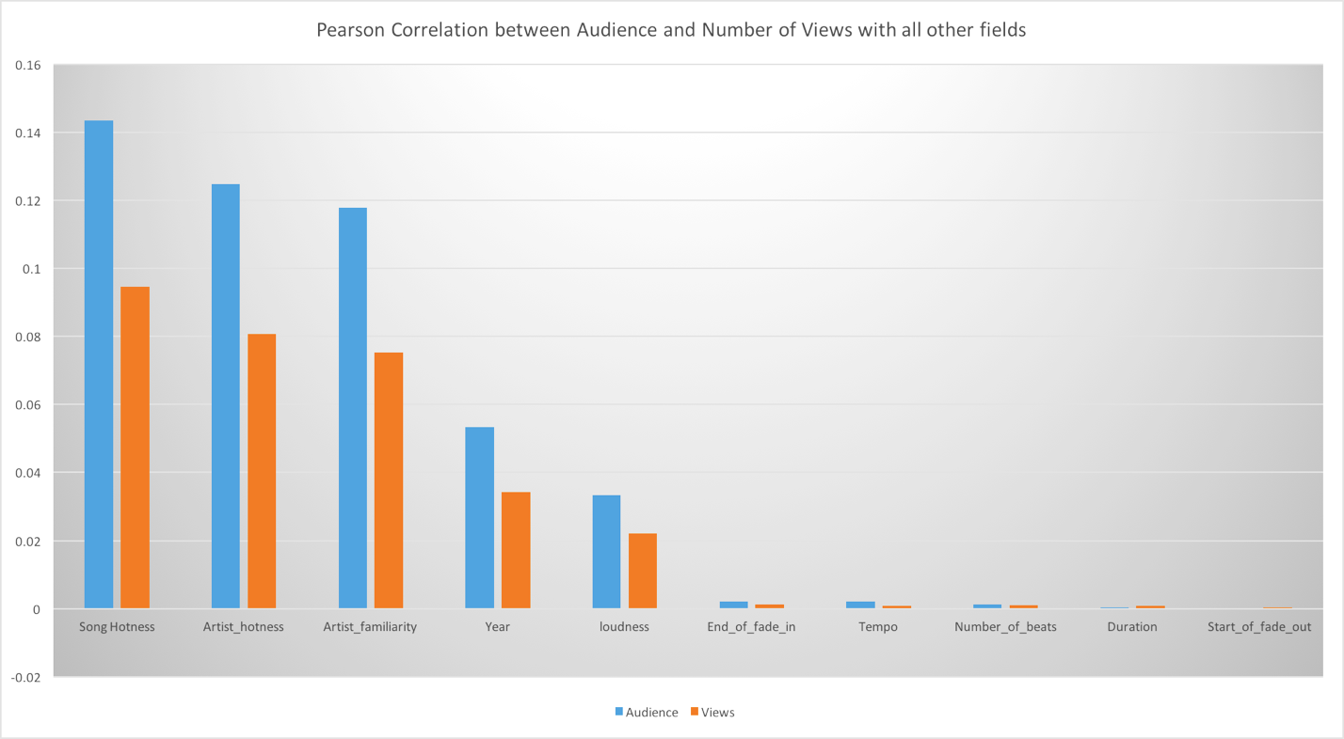
Predicting #Audience and #Views
Prediction of possible audience count and Number of play count is a regression problem. First step towards achieving this is preprocessing this dataset and cleaning the data.
Data Preparation:
The data is more or less preprocessed in the MR jobs already but we ensured its cleanliness by cleaning the missing data and removing duplicate rows.

Slide 21
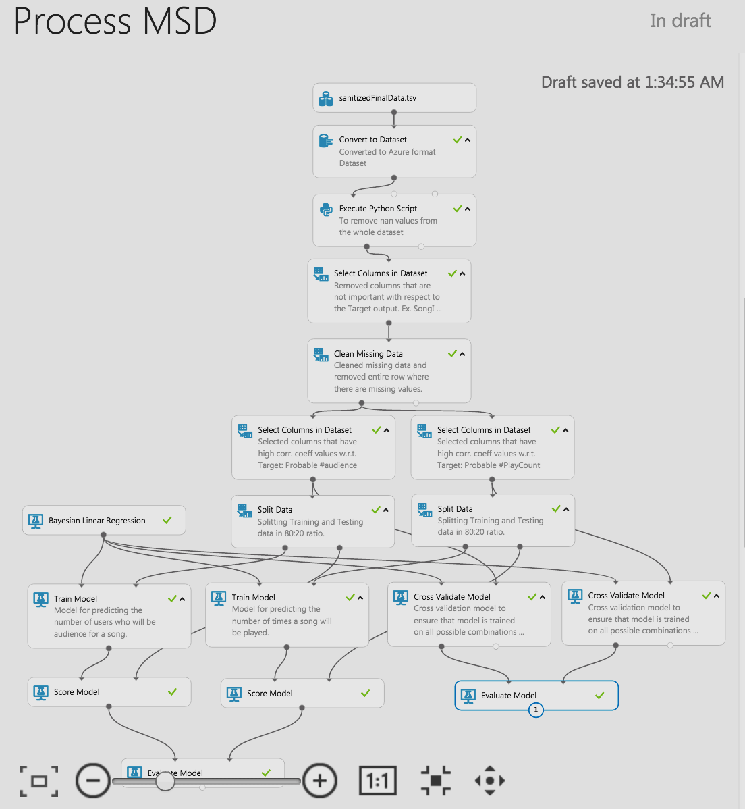
Prediction Model
Linear Regression Model

Slide 22
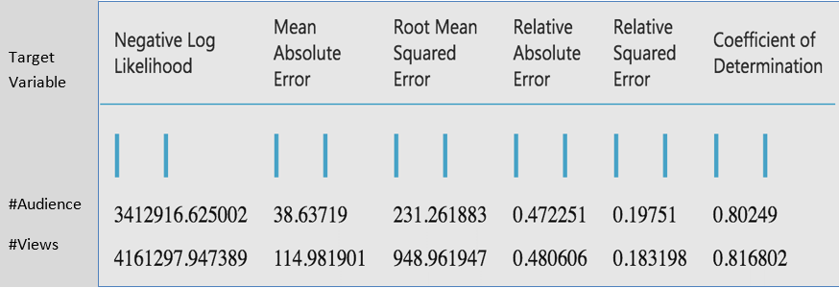
How Good or BAD we DiD ?
Standard Performance Parameters:

Slide 23
demo

Slide 24
Challenges
Huge data to crunch(approximately 280 GB).
Extracting data into CSV from HDF5. Unable to make it parallel on EMR.
Data Cleaning and preprocessing due to unavailable/junk values for certain fields.
Limited usage on Azure ML(only 10 GB free space).
Building the architecture in Neo4j with 2 nodes having a relationship.

Slide 25
References
http://labrosa.ee.columbia.edu/millionsong/
https://aws.amazon.com/datasets/million-song-dataset/
http://ismir2011.ismir.net/papers/OS6-1.pdf
http://blog.echonest.com/post/3639160982/million-song-dataset
https://neo4j.com/docs/developer-manual/current/drivers/#driver-introduction
https://hadoop.apache.org/docs/r1.2.1/mapred_tutorial.html
http://www.tutorialspoint.com/apache_pig/index.htm

Slide 26
Citation
Thierry Bertin-Mahieux, Daniel P.W. Ellis, Brian Whitman, and Paul Lamere. The Million Song Dataset. In Proceedings of the 12th International Society for Music Information Retrieval Conference (ISMIR 2011), 2011.

Slide 27
Fun(Parallelization) at Work

